Slide 1
Improving LLM-based Code Completion
Using LR Parsing-Based Candidates
SCSS 2024
August 28-30, Tokyo
Md Monir Ahammod Bin Atique
Chonnam National University, Korea
Kwanghoon Choi
Chonnam National University, Korea
Isao Sasano
Shibaura Institute of Technology, Japan
Hyeon-Ah Moon
Sogang University, Korea
Notes:
Good afternoon, everyone. My name is [Your Name] I am from CNU, and I am honored to be here today at SCSS 2024 conf. I am excited to share our latest research on “Improving….

Slide 2
Outline
Introduction
Motivation and Challenges
Overview of Our System
Implementation
Experiment
Results and Discussion
Conclusions and Future Directions
‹#›

Slide 3
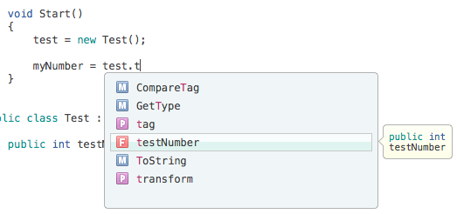
Introduction
Code completion or autocomplete is a crucial feature in modern IDEs.
The important feature of syntax completion in IDEs:
To offer suggestions for completing code segments based on the current context and syntax rules of the programming language.
The importance of syntax completion for efficient programming:
Learning aid, early detection of syntax errors, and boosts productivity.
‹#›
Notes:
keep track of the parameters you're typing, and add calls to properties and methods with only a few keystrokes

Slide 4
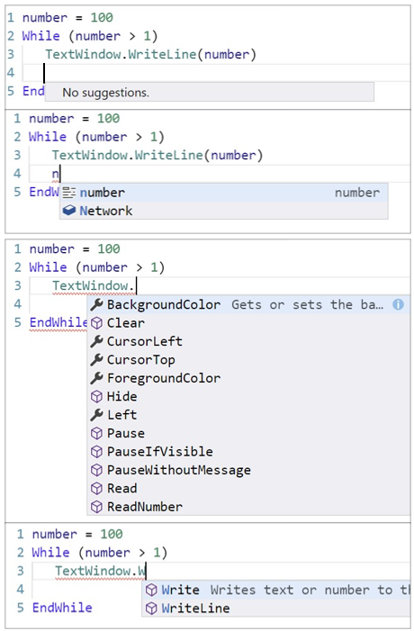
Examples: Identifier Completion in Microsoft SmallBasic
Highlight: Users require to type a character
cf. Identifier Completion for C11 in Visual Studio Code
‹#›
Notes:
There are some identifier completion in many IDEs. SB is developed by Microsoft which provides an easy, simple and fun interface for beginners to learn.

Slide 5
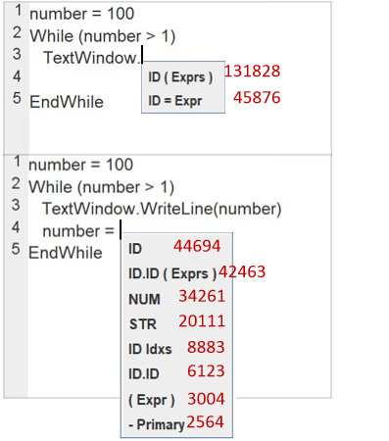
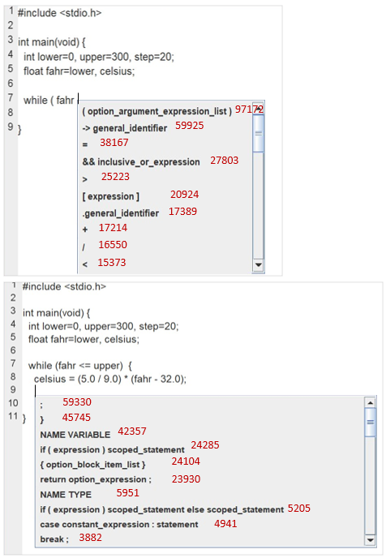
Our Previous System: Ranked Syntax Structure Completion for SmallBasic and C11 [ACM SAC 2024]
Suggest syntax structure candidates sorted by pre investigated frequencies.
SB
C11
‹#›
Notes:
For experimental purpose we selected two languagauge SB and C11.

Slide 6
Motivation and Challenges
The limitations of existing syntax completion methods
Mostly identifier completions, overwhelming choices, static suggestions.
The limitations of our previous syntax completion works [Sci. Comput. Program. 2023, ACM SAC 2024]
Only structural candidates, manually edit, time consuming.
The need for a code completion prediction method that
Offers textual suggestions rather than just structural ones.
Control the generation of LLM prediction with the aid of LR Parsing based candidates.
‹#›
Notes:
Shows only a list of variables and methods containing character written by the user which is word based code completion. Code Suggestion without entering a character

Slide 7
Contributions
The text-based ranked syntax completion method with LR parsing
Introduced a hybrid method combining LR-parsing-based candidate ranking
with LLM-based code generation.
Established an evaluation environment, testing on SmallBasic and C11 benchmarks.
Initial performance insights demonstrate the effectiveness of the proposed method.
‹#›
Notes:
To overcome the existing limitations we developed a new “text…

Slide 8
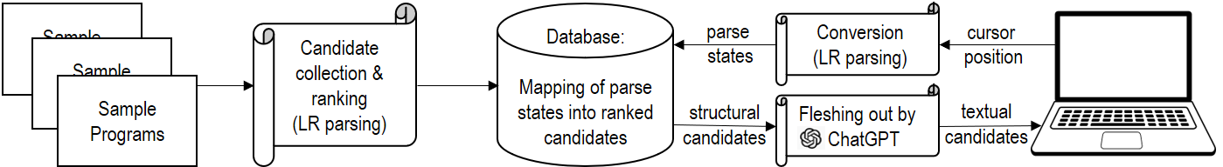
Overview of Our System
Two-phase approach: Collecting & ranking phase and Query phase
Collecting & ranking phase (offline)
Query phase (online)
Highlight: The use of ChatGPT in the system
- It fleshes out the structural candidates to produce textual candidates
- Ex: ID.ID(Expr) → TextWindow.WriteLine(“Hello World”)
‹#›

Slide 9
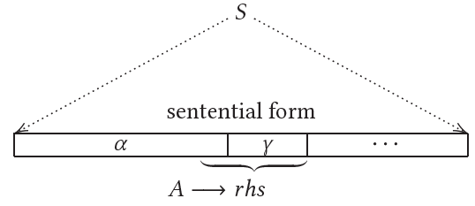
Collection and Ranking Phase (Structural Candidate)
What are structural candidates ?
The concept of suffix sentential form intuitively represents the remaining portion of the program text entered up to the current position [ACM PEPM 2021, Sci. Comput. Program. 2023].
Collecting a completion here
(Cursor position 3, i.e. S30)
TextWindow .
ID .
ExprStatement -> ID . ID ( Exprs )
Structural Candidate
α
γ
Cursor position
ID . ID ( EXPR )
TextWindow . WriteLine ( “Hello World” )
Suffix Sentential Forms
Notes:
The figure box shows what programmer see. Programmers have written “TextWindow” dot(.). Currently cursor at this position after the dot. At this point, he /she wants to the editor to complete the rest of the part of this line of code. Then our system does LR parse. And it produces ID and dot put this in our system. Look at the production rules, our system found out ID is referred to the alpha (@). Next, our system gets the rest of the symbols from the production rules. Then it referred the red text as gamma. Our system considered the gamma part as structural candidate. This is not enough or completed. We ask the ChatGPT to decorate the structural candidate by giving prefix what programmer writes before asking for code suggestion and the structural candidate. If we were lucky we can get the correct answer (code) as code suggesstions.....This is the Ideal situation of our system.

Slide 10
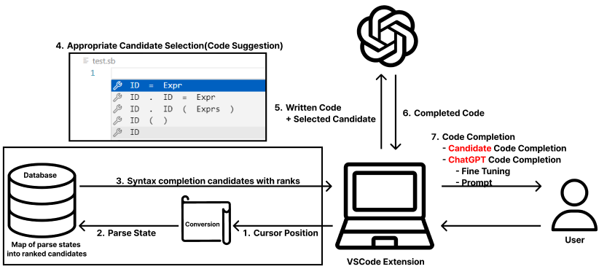
Overview of Online Query Phase
Using VSCode Extension user requests ChatGPT for Code Completion
Notes:
The user generates an event that sends the current cursor position information to the SmallBasic Parser via a shortcut key. The SmallBasic Parser finds a list of possible syntax candidates based on the current cursor position information and presents them to the user in the form of code suggestions.

Slide 11
Implementation
Prompt Design in Python
prompt = f"""
This is the incomplete {prog_lan} programming language code:
{resulted_prefix}
'{modified_struct_candi}'
Complete the '{modified_struct_candi}' part of the code in the {prog_lan} programming language. Just show your answer in place of '{modified_struct_candi}'."""
Example:
prog_lan = ‘Small Basic’
resulted_prefix = ‘TextWindow . ’
modified_struct_candi = ‘Identifier ( Expression )’
prompt = f"""
This is the incomplete Small Basic programming language code:
TextWindow .
'Identifier ( Expression )'
Complete the 'Identifier ( Expression )' part of the code in the Small Basic programming language. Just show your answer in place of 'Identifier ( Expression )'."""

Slide 12
Implementation (Cont.)
2. Fleshing out with ChatGPT
Parse State: 30 Cursor Position: 1 12
This is the incomplete Small Basic programming language code:
TextWindow.
'Identifier ( Expression )'
Complete the 'Identifier ( Expression )' part of the code in the Small Basic programming language. Just show your answer in place of
'Identifier ( Expression )'.
Received response: WriteLine("Hello, World!")
Actual Result: WriteLine("Hello World") !!!!
Full line of code: TextWindow.WriteLine("Hello, World!")

Slide 13

Demo
Live demo of the VSC Extension for Small Basic programming language
Credits: Seokwoo Yang, Shin Hyo-won, Hyojeong Kang

Slide 14
Experiment Environment
Integrated Development Environment (IDE): VSCode 1.89.1
ChatGPT Model: gpt-3.5-turbo-0125
‹#›

Slide 15
Evaluation Methodology
The datasets used for training (candidate collection):
SmallBasic community programs: 3,701 programs encompassing nearly
789,023 lines of code.
C11 open-source projects(cJSON, lcc, bc, gzip, screen, make, tar): 412 programs, totaling approximately 308,599 lines of code.
The datasets used for testing:
Microsoft SB tutorial: 27 programs spanning 155 lines of code.
The Kernighan and Ritchie’s book on the C programming language: 106 exercise programs totaling 11,218 lines of code.
‹#›
Notes:
Dataset splitting (training and testing) AND ref ACM SAC paper

Slide 16
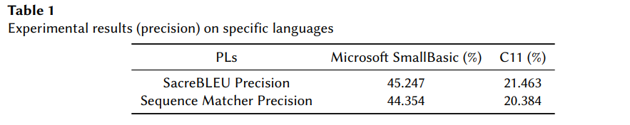
Evaluation Results: SmallBasic and C11
‹#›
Notes:
Dataset splitting (training and testing) AND ref ACM SAC paper

Slide 17
Evaluation Results: Performance Analysis
A comparison with and without LR candidate guidance:
Experimental Results with Candidate Guidance
PLs | Microsoft SmallBasic (%) | C11 (%)
SacreBLEU Precision | 45.247 | 21.264
Sequence Matcher Precision | 44.354 | 20.384
Experimental Results without Candidate Guidance
PLs | Microsoft SmallBasic (%) | C11 (%)
SacreBLEU Precision | 34.983 | 11.593
Sequence Matcher Precision | 34.942 | 11.863
‹#›

Slide 18
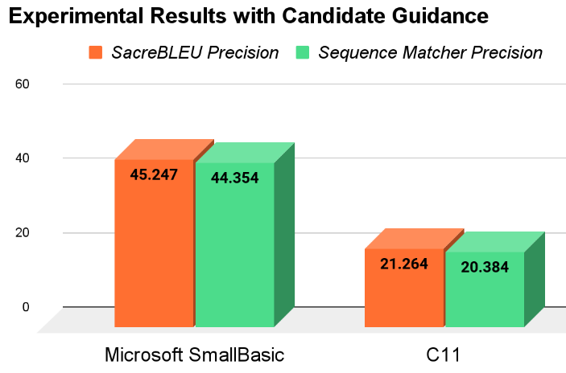
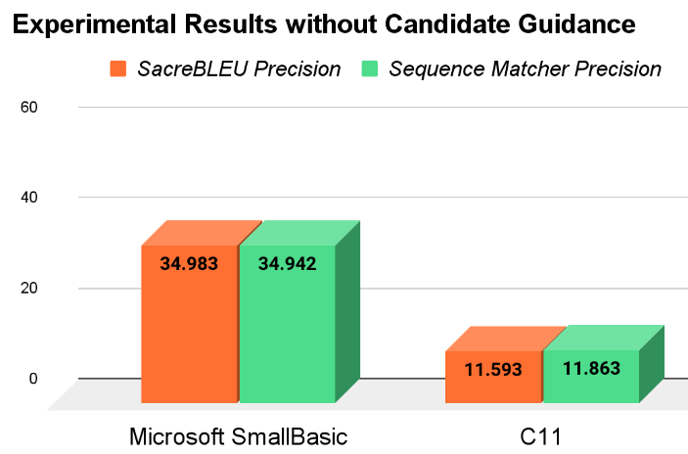
Evaluation Results: Performance Analysis
A comparison bar chart with and without LR candidate guidance:
‹#›

Slide 19
Evaluation Results: Performance Analysis (Cont.)
ChatGPT Response with Candidate Guidance
This is the incomplete Small Basic programming language code:
For i = 1 To 5
TextWindow
'.Identifier ( Expression )'
Complete the '.Identifier (Expression)' part of the code in the Small Basic programming language.
Just show your answer in place of '.Identifier ( Expression )'.
Received response: .WriteLine("Iteration " + i)
SacreBLEU 1 gram precision: 77.77
ChatGPT Response without Candidate Guidance
This is the incomplete Small Basic programming language code:
For i = 1 To 5
TextWindow
'next token or line'
Complete the 'next token or line' part of the code in the Small Basic programming language.
Just show your answer in place of 'next token or line'.
Received response: EndFor
Actual result: . Write ("User" + i + ",enter name: ")
SacreBLEU 1 gram precision: 0.0
‹#›

Slide 20
Evaluation Results: Performance Analysis (Cont.)
ChatGPT Response with Candidate Guidance
This is the incomplete Small Basic programming language code:
For i = 1 To 5
TextWindow
……….
Received response: .WriteLine("Iteration " + i)
ChatGPT Response without Candidate Guidance
This is the incomplete Small Basic programming language code:
For i = 1 To 5
TextWindow
…….
Received response: EndFor
.Write("Text")
.Clear()
.Read()
Actual result: . Write ("User" + i + ",enter name: ")
ChatGPT’s Textual Candidate List Suggestions Without Candidate Guidance
‹#›

Slide 21
Evaluation Results: Performance Analysis
Why do we have a performance difference with candidate guidance using ChatGPT?
ChatGPT's performance improves when given well-structured prompts as tokens, leading to more accurate responses.
Despite not teaching terminal or non-terminal symbols, ChatGPT appears to understand them, likely due to human-readable naming conventions.
Why do we have nearly 10% difference in evaluation performance between SB and C11?
SB programs are shorter with fewer tokens and production rules.
C11 has significantly longer programs with more tokens and production rules compared to SB.
Notes:
ChatGPt’s performance depends on Prompt’s (token).. With candidate structure we provide appropriate information as token to the ChatGPT to produce accurate response not arbitrary ones. We donnot teach it whether these symbols are terminal and non- terminal.Also, we didnot the teach it the meaning of those symbols at this moment but ChatGPT seems to know the meaning of those symbols according to our experiment results. We guess that symbols are named in a human readable way using English that ChatGPT excels at understanding. In future we will teach…

Slide 22
Conclusions
Introduced a method to automatically compose prompts using structural candidates with the aid of LR-parsing based method.
Assessed the approach using two programming languages for evaluation.
Enhanced the system to suggest textual candidates, improving upon previous work.
Successfully guided the LLM to exclude low-ranking structural candidates in code completion.
‹#›

Slide 23
Future Directions
Build an IDE to streamline and enhance usability testing and evaluation.
Measure the effectiveness of different structural candidates used in prompts when interacting with LLMs.
Conduct a comparative analysis of the system's prediction performance against other related researches, with a focus on those based on LLMs.
Teach ChatGPT the programming language grammar to better understand LR candidates.
‹#›

